Slide 1
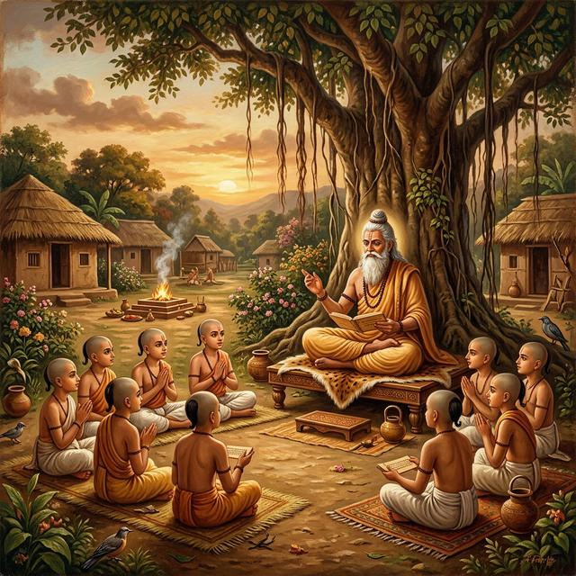
Pedagogy and Ancient Universities: Gurukul System and Guru Shishya Parampara, Institutional Structure of Nalanda, Takshashila & Vikramshila
Debutpal Bora
Assistant Professor
Dept . Of Political Science
Nabajyoti College
add picture aso
Pedagogy refers to the theory, method, and practice of teaching. In simple terms, it means how a teacher teaches and how students learn.

Slide 2
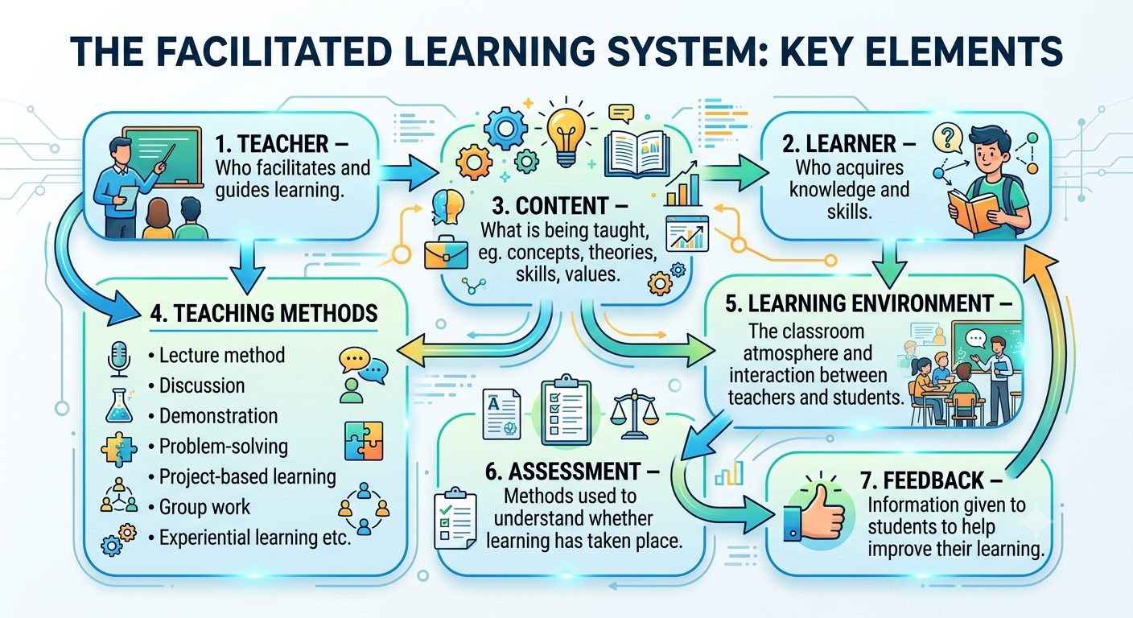
Teacher – Who facilitates and guides learning.
Learner – Who acquires knowledge and skills.
Content – What is being taught, eg. concepts, theories, skills, values.
Teaching methods –
  Lecture method
  Discussion
  Demonstration
  Problem-solving
  Project-based learning
  Group work
  Experiential learning etc.
Learning environment – The classroom atmosphere and interaction between teachers and students.
Assessment – Methods used to understand whether learning has taken place.
Feedback – Information given to students to help improve their learning.
Make in a diagram format
Major Elements of Pedagogy

Slide 3
Guru means teacher, one who removes darkness; Kula means extended family or home.
Gurukul: Learning in a family-like environment.
Residential Learning under a Guru
Student-Centered Teaching: Based on ability, basic education to all.
Oral Tradition
Value-Oriented Education: Seva, Discipline, Sanskar
Holistic Education: Mental, Physical, Spiritual, Growth, Character building
Learning by doing.
Features
Of
Gurukul

Slide 4
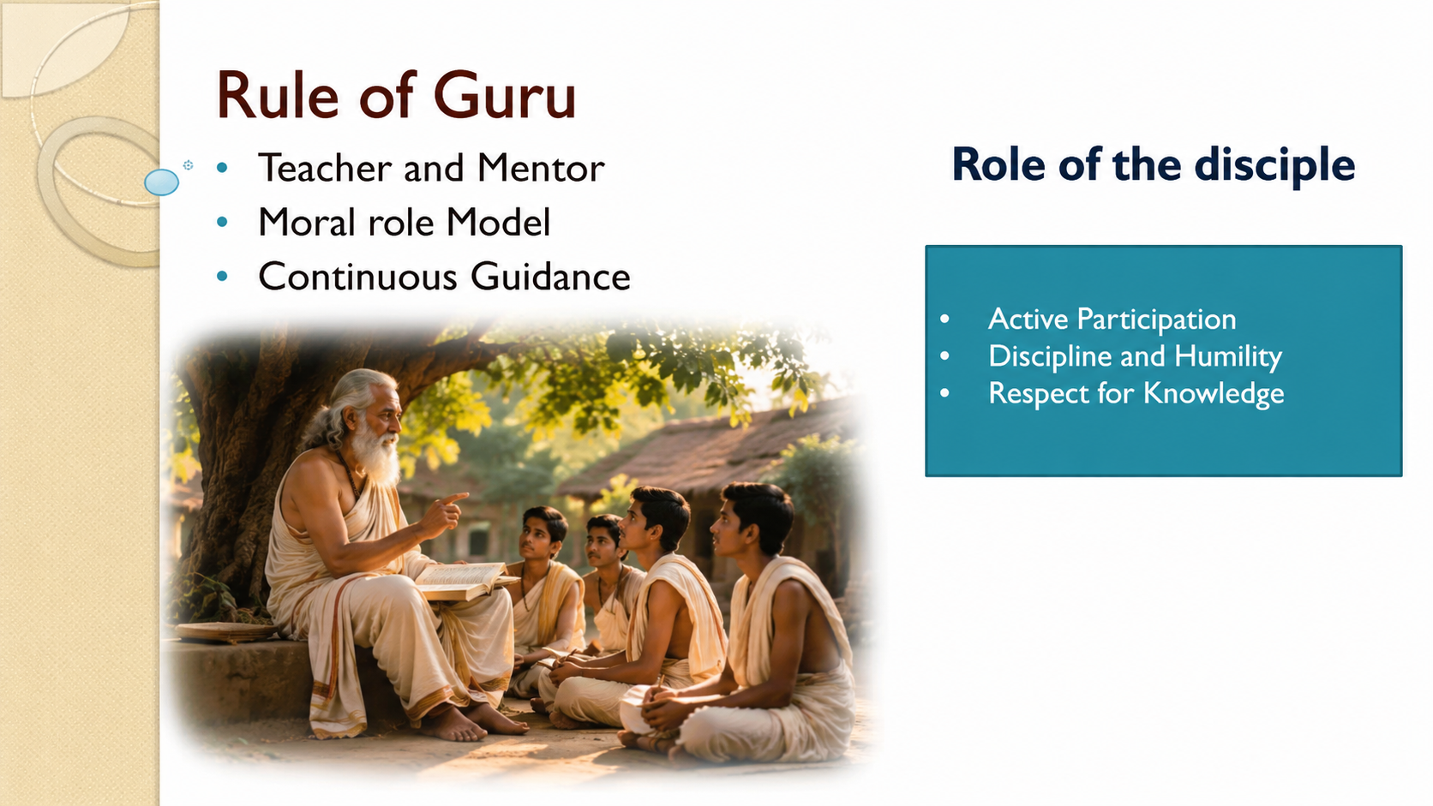
Three stages of learning
Shravana- Listening
Manana- Reflection
Nididhyasana- Internalization

Slide 5
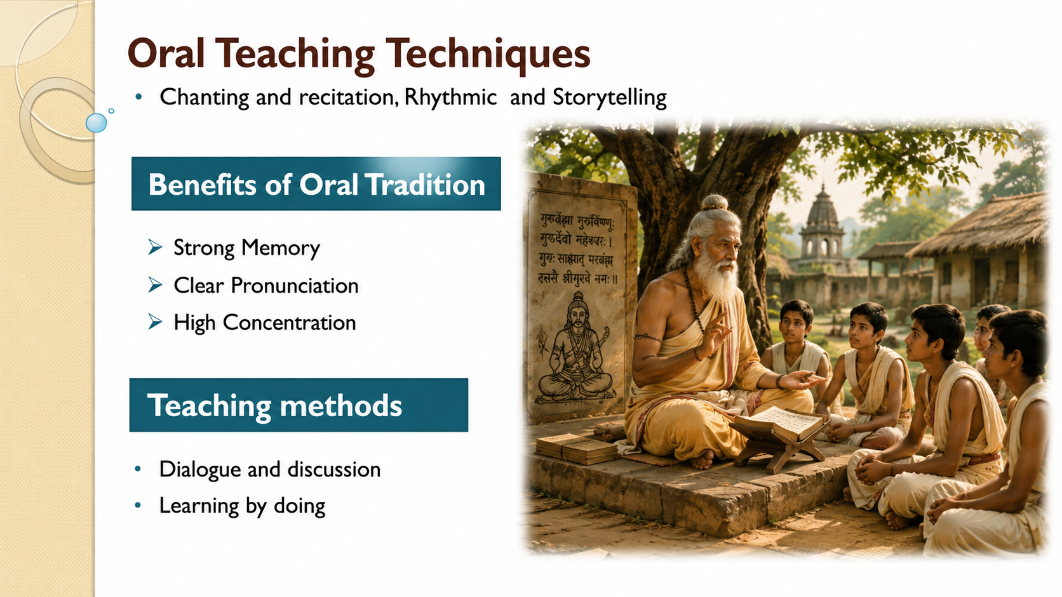
Oral Teaching Techniques
Chanting and recitation, Rhythmic and Storytelling
Benefits of Oral Tradition
Strong Memory
Clear Pronunciation
High Concentration
Teaching methods
Dialogue and discussion
Learning by doing

Slide 6
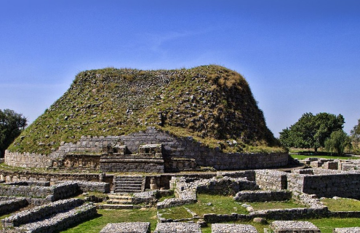
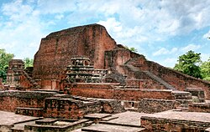
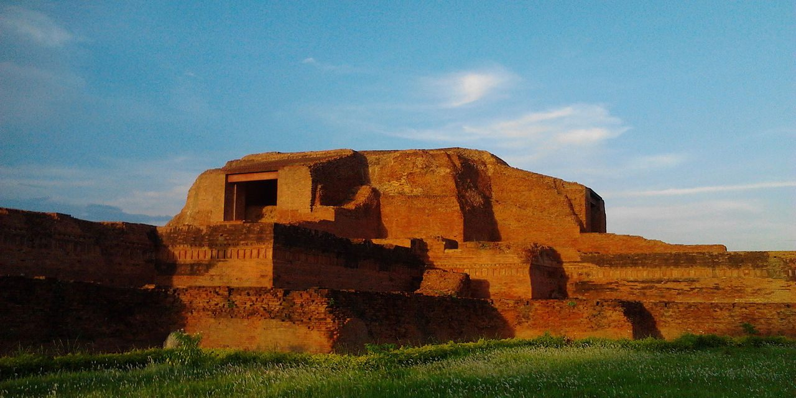
Ancient Indian Centres of Higher Learning
Takshashila University
Nalanda University
Vikramshila University

Slide 7
Introduction
Takshashila represented an early teacher-centred model of higher learning.
Nalanda and Vikramshila developed as large residential Buddhist monastic institutions.
These centres attracted scholars and students from different regions.

Slide 8
Takshashila (Taxila): Historical Background
Gandhara, in present-day Punjab, Pakistan.
An important centre of learning from around the 6th century BCE.
Flourished for several centuries because of its strategic location on trade and cultural routes.
Better understood as a major centre of learning rather than a modern university with one central campus.
Scholars such as Panini, Kautilya and Jivaka.

Slide 9
Takshashila: Institutional Structure
Teacher-centred and relatively decentralised educational system.
No single central university administration like a modern university.
Students studied under individual teachers or scholarly schools.
Students often lived with or near their teachers.
Teachers enjoyed considerable autonomy in teaching and specialised subjects.

Slide 10
Takshashila: Curriculum & Pedagogy
Subjects: Vedic studies, grammar, philosophy, medicine, politics, law, economics, military science, mathematics and astronomy.
Pedagogy: oral instruction, memorisation, questioning, discussion and debate.
Practical training was important in fields such as medicine and military studies.
Close teacher–student interaction was central to learning.
Learning combined theoretical knowledge with practical skills.

Slide 11
Nalanda: Historical Background
Located in present-day Bihar, India.
Nalanda is generally associated with the Gupta period, particularly the reign of Kumaragupta I in the 5th century CE. It continued to develop under later rulers, especially the Harsha and Pala dynasties.Received patronage from Gupta and later Pala rulers.
Attracted students and scholars from different parts of Asia.
Xuanzang (Hiuen Tsang) – Chinese Buddhist scholar and traveller Yijing (I-Tsing) – Chinese Buddhist monk and school

Slide 12
Nalanda: Institutional Structure
Large residential monastic educational institution.
Students and teachers lived within the monastery complex.
Had organised monastic administration and academic leadership.
Admission was selective and intellectual preparation was expected.
Famous library complex traditionally associated with Ratnasagara, Ratnodadhi and Ratnaranjaka.
Supported through royal patronage, donations and grants.

Slide 13
Nalanda: Curriculum & Pedagogy
Subjects included Buddhist philosophy, logic, grammar, medicine, mathematics, astronomy and literature.
Teaching included lectures, debate, discussion and textual study.
Intellectual debate was an important part of advanced learning.
Teacher–student interaction remained central within an organised residential system.
Nalanda combined religious education with broader scholarly studies.
Teacher → Lecture & Explanation → Student Questioning → Debate → Discussion → Critical Reasoning → Mastery

Slide 14
Key Features of Nalanda's Education System
Feature | Description
Residential Education | Students and teachers lived within the institution.
International Centre | Students came from China, Korea, Tibet, Central Asia and Southeast Asia.
Teacher–Student Relationship | Close interaction between teachers and students was an important feature.
Disciplined Life | Students followed institutional rules and a disciplined daily routine.
Debate and Discussion | Learning involved discussion, debate, questioning and reasoning.
Libraries | Nalanda had extensive collections of manuscripts and scholarly works.
Admission | Admission was selective and students were expected to demonstrate intellectual ability.

Slide 15
Vikramshila: Historical Background
Located in present-day Bihar, India.
Established by Pala ruler Dharmapala, probably in the late 8th or early 9th century CE.
Developed into a major centre of advanced Buddhist learning.
Maintained strong connections with Tibet and wider Buddhist scholarship.
Atisha Dipankara was one of the famous scholars associated with Vikramshila.

Slide 16
Vikramshila: Institutional Structure
Organised as a large residential Buddhist monastery.
Traditional accounts describe Vikramshila
The Six-Gate System was a mechanism through which Vikramashila maintained academic standards by placing eminent scholars at its gates who could examine students and scholars through questioning and debate.
Teachers and students lived within the monastic complex.
Supported by Pala royal patronage.
Strong emphasis on advanced Buddhist philosophy and scholarship.

Slide 17
Vikramshila: Curriculum & Pedagogy
Major areas: Buddhist philosophy, logic, grammar, metaphysics and tantric Buddhism.
Teaching involved textual study, explanation, discussion and debate.
Advanced scholarship and teacher-guided study were important.
International intellectual exchange, especially with Tibet, was significant.

Slide 18
Comparative Institutional Structure
Takshashila: decentralised, teacher-centred and school-based.
Nalanda: large, residential and institutionally organised monastic university.
Vikramshila: residential monastic institution with a structured academic and gate system.
All three emphasised teacher–student interaction and scholarly learning.
Their institutional forms changed according to historical and religious contexts.

Slide 19
Conclusion
Takshashila, Nalanda and Vikramshila represent important traditions of higher learning in ancient India.
They demonstrate different models of institutional organisation and pedagogy.
Takshashila highlights the teacher-centred model.
Nalanda and Vikramshila demonstrate large-scale residential monastic education.
Their legacy remains important for understanding the history of education in South Asia.

